Slide 1
Advanced Image Analysis
2017-2018, 2nd semester
Binary images
Alessandro Bria
Contract Professor
and Post-doc Researcher
email: a.bria@unicas.it

Slide 2
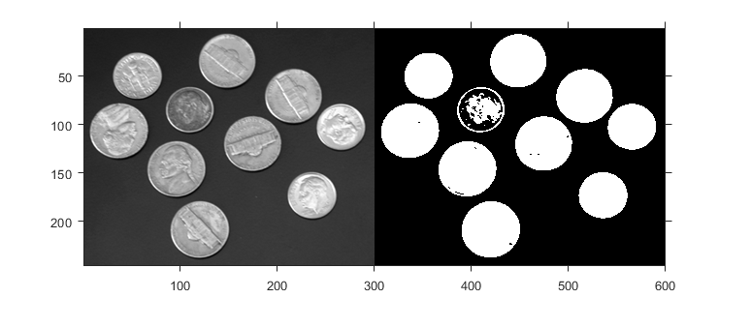
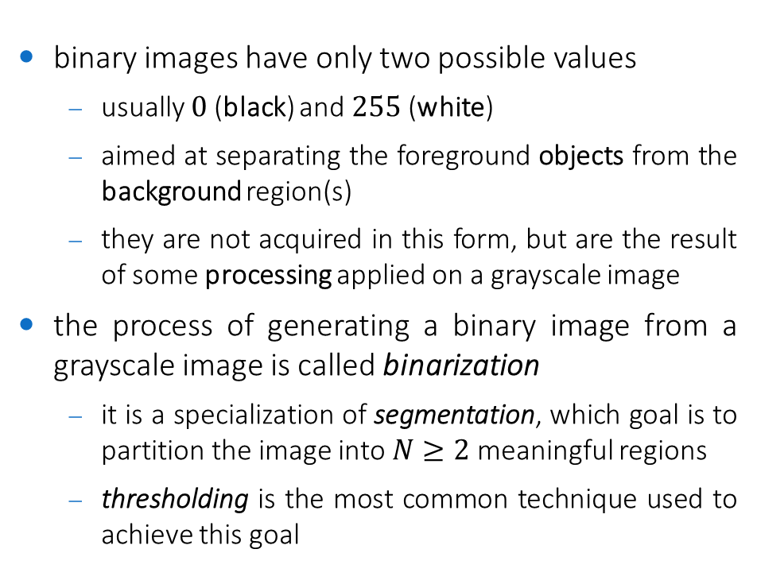
Binary images
binary images have only two possible values
usually $0$(black) and $255$(white)
aimed at separating the foreground objects from the background region(s)
they are not acquired in this form, but are the result of some processing applied on a grayscale image
the process of generating a binary image from a grayscale image is called binarization
it is a specialization of segmentation, which goal is to partition the image into $N≥2$ meaningful regions
thresholding is the most common technique used to achieve this goal

Slide 3
Thresholding

Slide 4
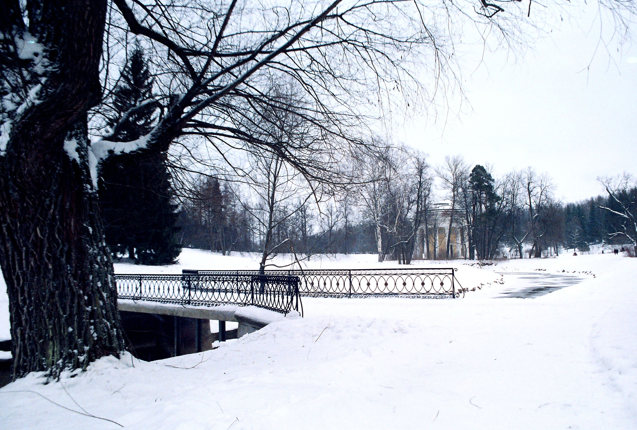
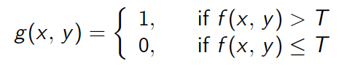
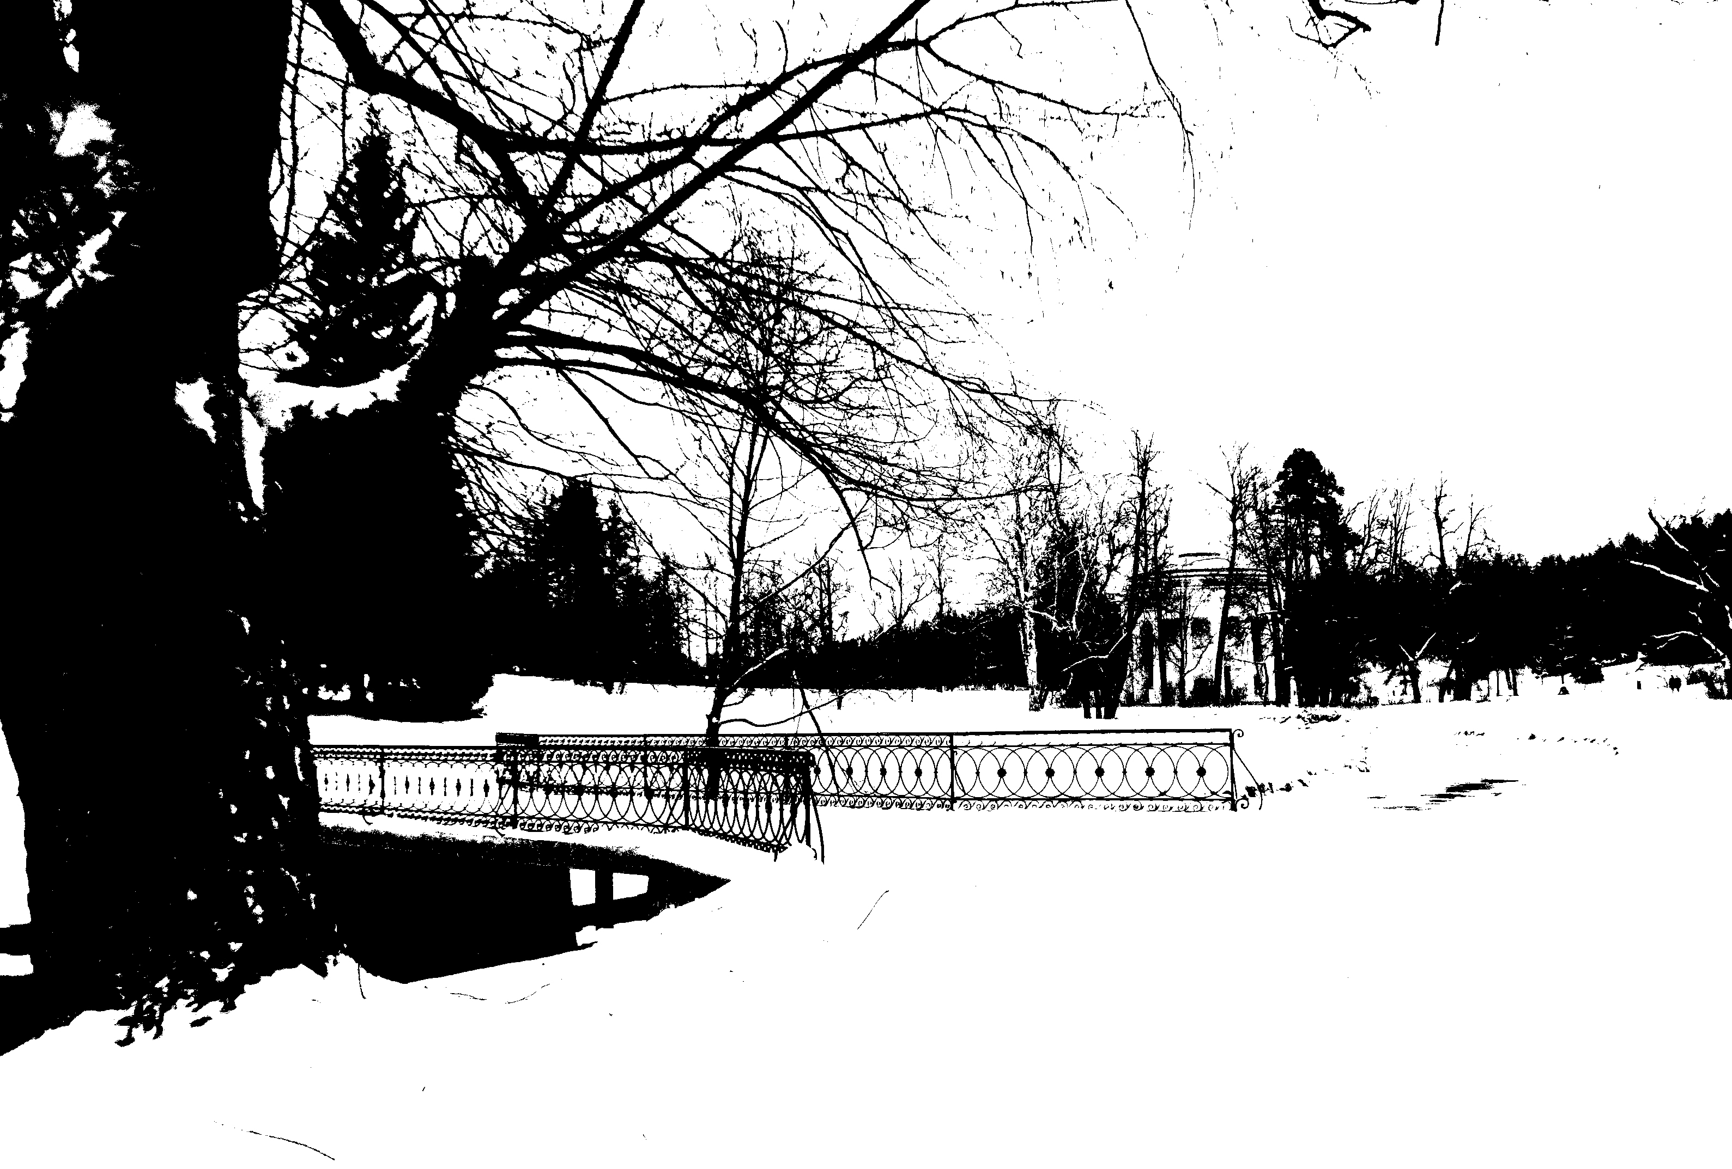
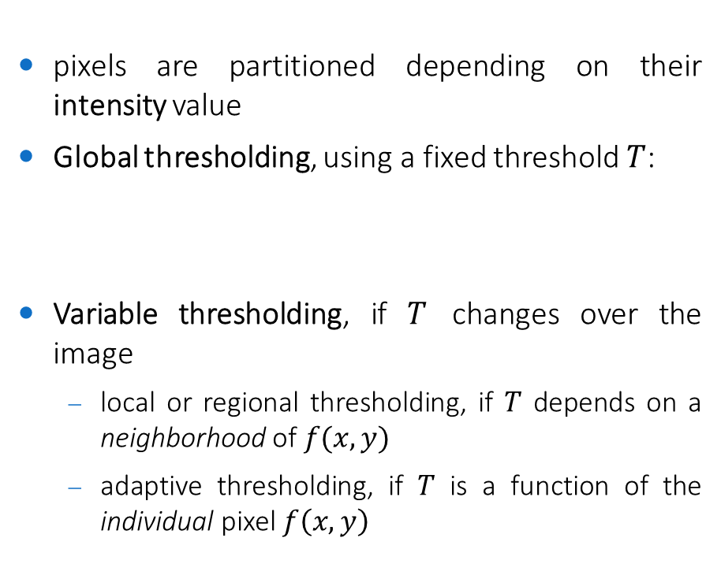
Thresholding
pixels are partitioned depending on their intensity value
Global thresholding, using a fixed threshold $T$:
Variable thresholding, if $T$ changes over the image
local or regional thresholding, if $T$ depends on a neighborhood of $f(x, y)$
adaptive thresholding, if $T$ is a function of the individual pixel $f\left(x,y\right)$

Slide 5
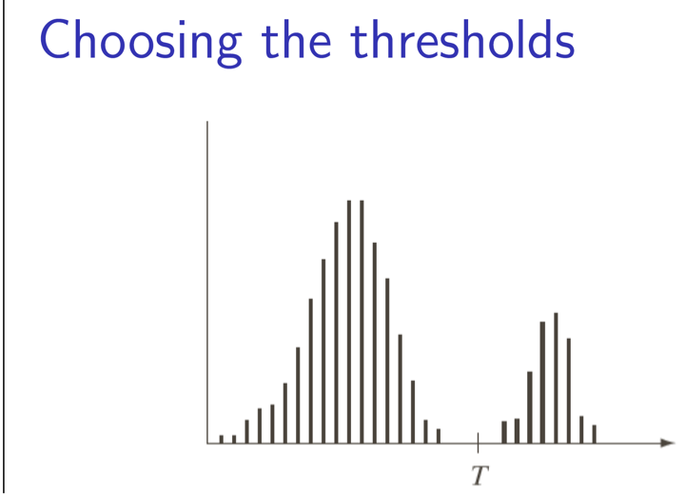
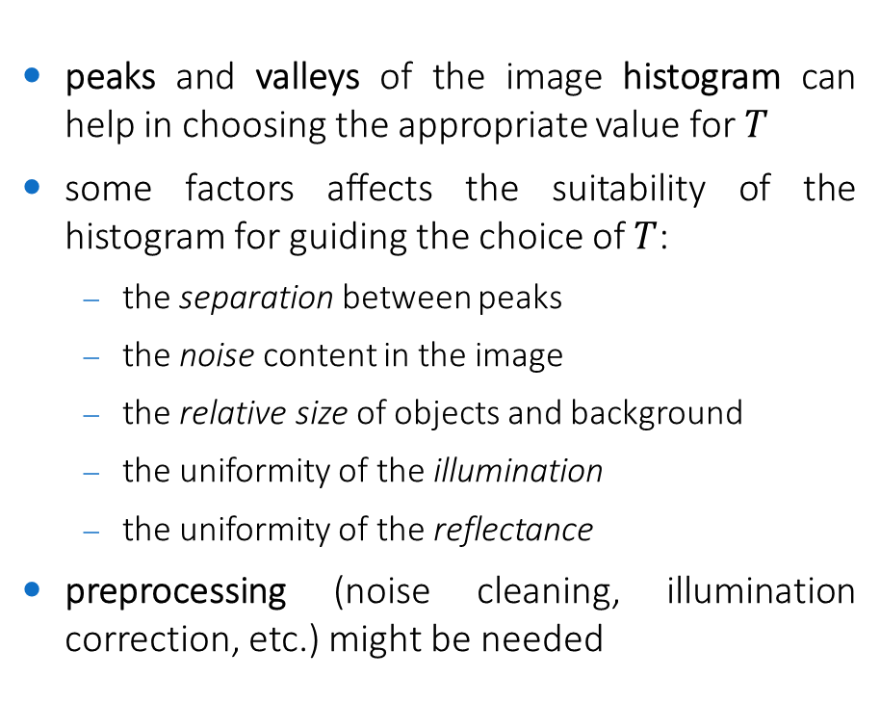
Choosing the threshold $T$
peaks and valleys of the image histogram can help in choosing the appropriate value for $T$
some factors affects the suitability of the histogram for guiding the choice of $T$:
the separation between peaks
the noise content in the image
the relative size of objects and background
the uniformity of the illumination
the uniformity of the reflectance
preprocessing (noise cleaning, illumination correction, etc.) might be needed

Slide 6
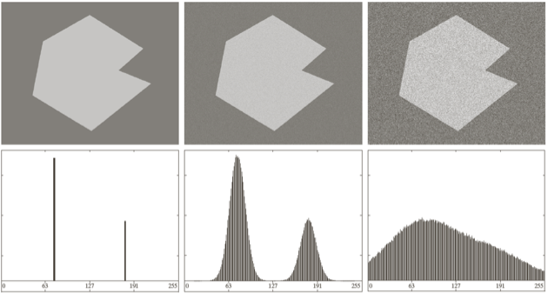
Noise role in thresholding
no noise
10% noise
50% noise

Slide 7
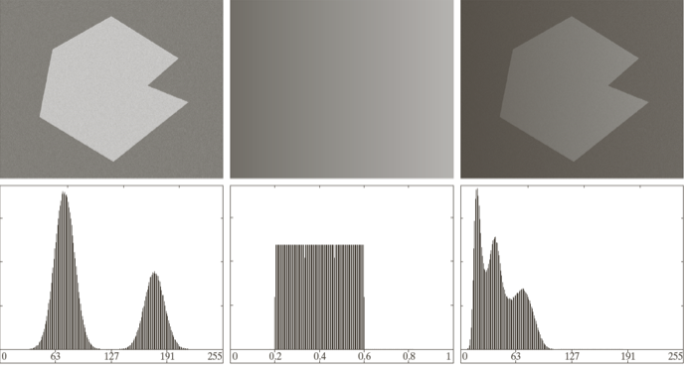


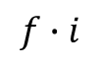
Illumination and reflection role in thresholding
$$f$$
$$i$$
$$f∙i$$

Slide 8
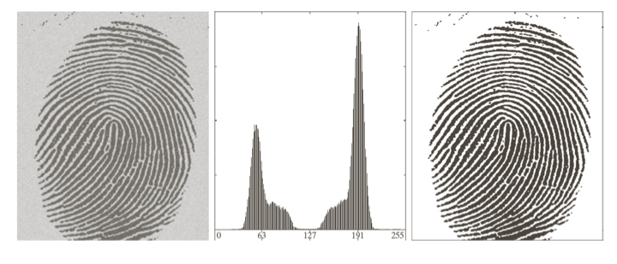
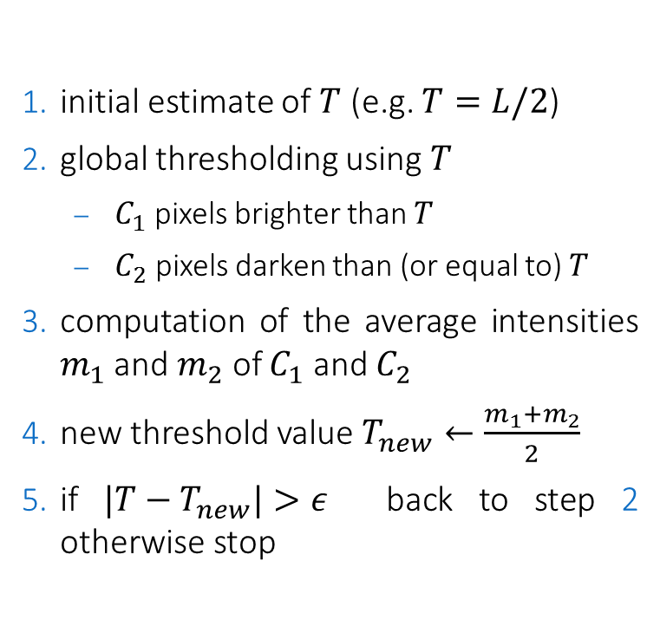
Global thresholding: a simple algorithm
initial estimate of $T$ (e.g. $T=L/2$)
global thresholding using $T$
$C_{1}$ pixels brighter than $T$
$C_{2}$ pixels darken than (or equal to) $T$
computation of the average intensities $m_{1}$ and $m_{2}$ of $C_{1}$ and $C_{2}$
new threshold value $T_{new}←\frac{m_{1}+m_{2}}{2}$
if $|T−T_{new}|>ε$ back to step 2 otherwise stop
works well only if the histogram is bimodal

Slide 9

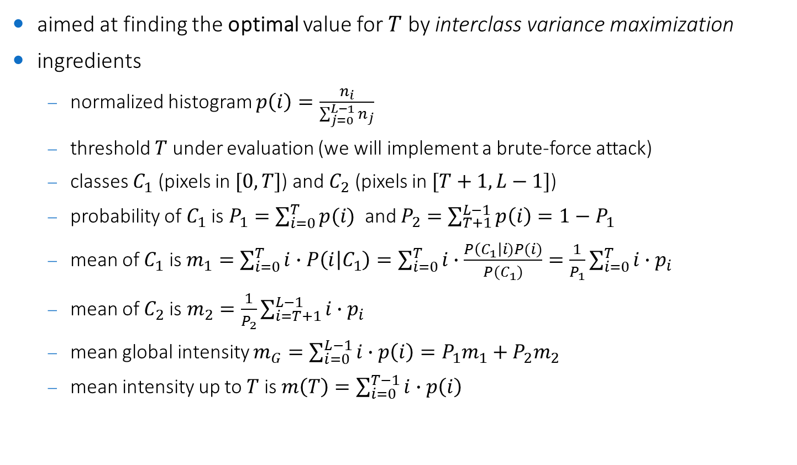
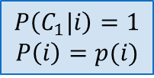
Otsu's method
aimed at finding the optimal value for $T$ by interclass variance maximization
ingredients
normalized histogram $p\left(i\right)=\frac{n_{i}}{\sum_{j=0}^{L−1}{n_{j}}}$
threshold $T$ under evaluation (we will implement a brute-force attack)
classes $C_{1}$ (pixels in $[0,T]$) and $C_{2}$ (pixels in $[T+1,L−1]$)
probability of $C_{1}$ is $P_{1}=\sum_{i=0}^{T}{p(i)}$ and $P_{2}=\sum_{T+1}^{L−1}{p\left(i\right)=1−P_{1}}$
mean of $C_{1}$ is $m_{1}=\sum_{i=0}^{T}{i∙P\left(i | C_{1}\right)=\sum_{i=0}^{T}{i∙\frac{P\left(C_{1}\right|i)P(i)}{P(C_{1})}=\frac{1}{P_{1}}\sum_{i=0}^{T}{i∙p_{i}}}}$
mean of $C_{2}$is $m_{2}=\frac{1}{P_{2}}\sum_{i=T+1}^{L−1}{i∙p_{i}}$
mean global intensity $m_{G}=\sum_{i=0}^{L−1}{i∙p\left(i\right)=P_{1}m_{1}+P_{2}m_{2}}$
mean intensity up to $T$ is $m\left(T\right)=\sum_{i=0}^{T−1}{i∙p\left(i\right)}$
$$P\left(C_{1}|i\right)=1$$
$$P\left(i\right)=p(i)$$
Bayes's Theorem $P\left(A | B\right)=\frac{P\left(B \right|A )P(A)}{P(B)}$

Slide 10
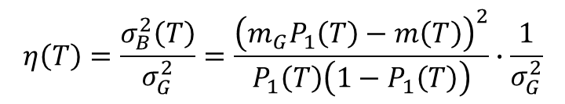
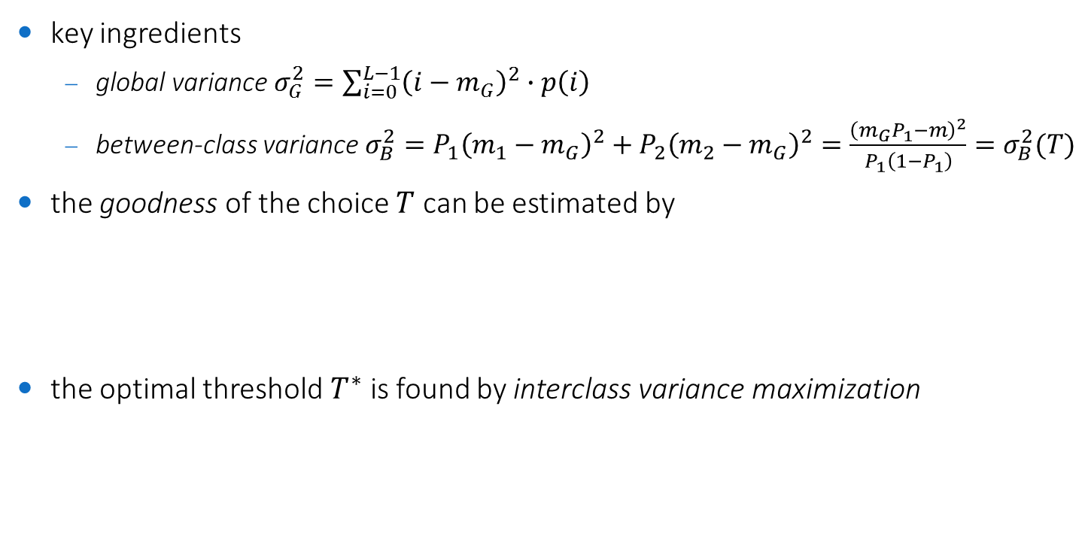
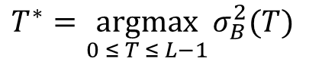
Otsu's method
key ingredients
global variance $σ_{G}^{2}=\sum_{i=0}^{L−1}{{\left(i−m_{G}\right)}^{2}∙p\left(i\right)}$
between-class variance $σ_{B}^{2}=P_{1}{\left(m_{1}−m_{G}\right)}^{2}+P_{2}{\left(m_{2}−m_{G}\right)}^{2}=\frac{{\left(m_{G}P_{1}−m\right)}^{2}}{P_{1}\left(1−P_{1}\right)}=σ_{B}^{2}(T)$
the goodness of the choice $T$ can be estimated by
the optimal threshold $T^{∗}$ is found by interclass variance maximization
$$η\left(T\right)=\frac{σ_{B}^{2}\left(T\right)}{σ_{G}^{2}}=\frac{{\left(m_{G}P_{1}\left(T\right)−m\left(T\right)\right)}^{2}}{P_{1}\left(T\right)\left(1−P_{1}\left(T\right)\right)}∙\frac{1}{σ_{G}^{2}}$$
$$T^{∗}=\underset{0 ≤ T ≤ L−1}{argmax}{σ_{B}^{2}(T)}$$

Slide 11
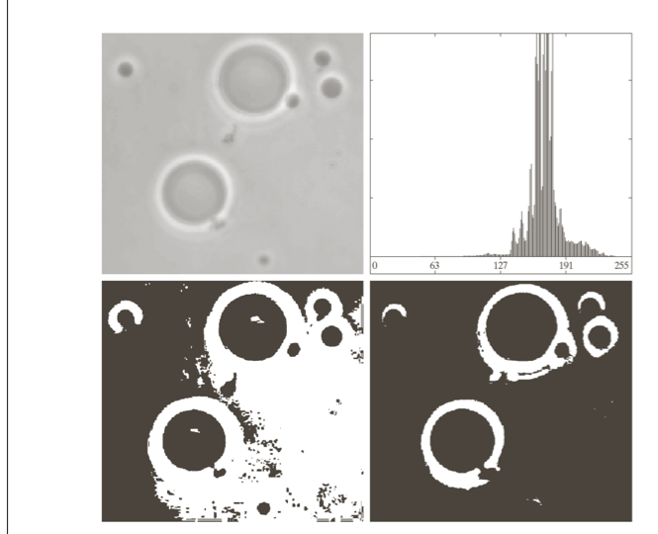
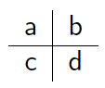
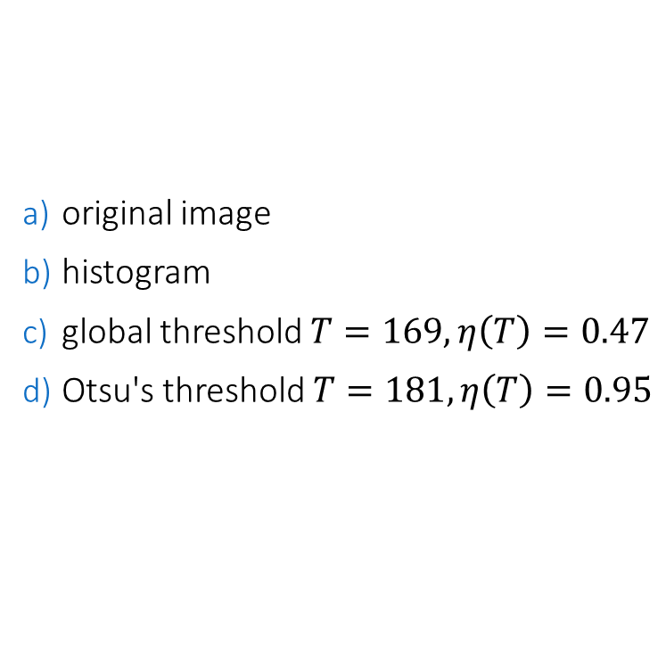
Otsu's method: example
original image
histogram
global threshold $T=169, η\left(T\right)=0.47$
Otsu's threshold $T=181, η\left(T\right)=0.95$

Slide 12
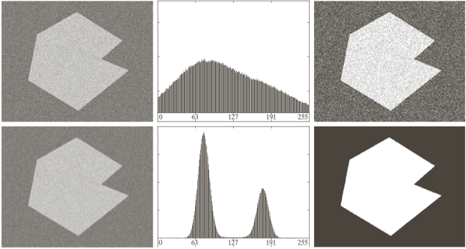
Global thresholding on noisy images
global thresholding may not work in presence of noise
smoothing can help to produce a histogram with separated peaks
original
smoothed
input
histogram
Otsu thresholding

Slide 13
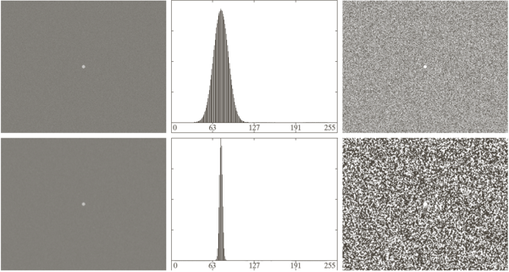
Global thresholding on unbalanced images
global thresholding may not work on unbalanced images (too small/large objects)
smoothing does not help in this case
original
smoothed
input
histogram
Otsu thresholding

Slide 14
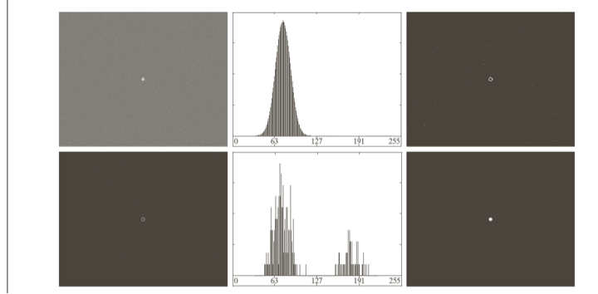
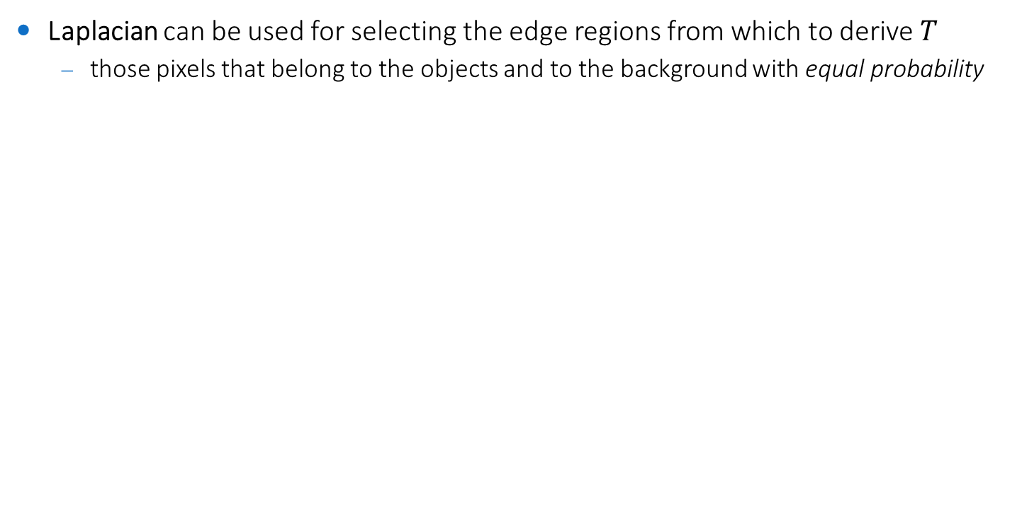
Global thresholding on unbalanced images
Laplacian can be used for selecting the edge regions from which to derive $T$
those pixels that belong to the objects and to the background with equal probability
original
Laplacian
input
histogram
Otsu thresholding

Slide 15
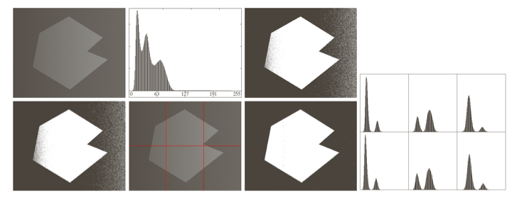
Variable thresholding: image partitioning
to face nonuniform illumination, the image is partitioned and the thresholding is operated on each partition
in each partition, the illumination is supposed uniform
in each partition, objects and background have to be equally represented

Slide 16
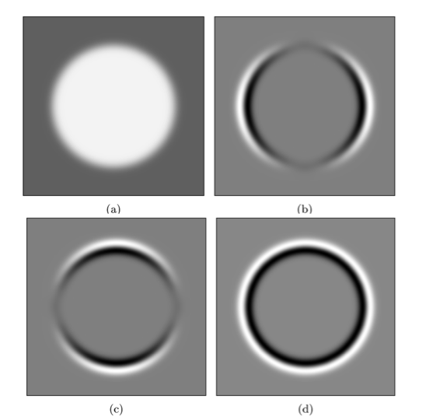
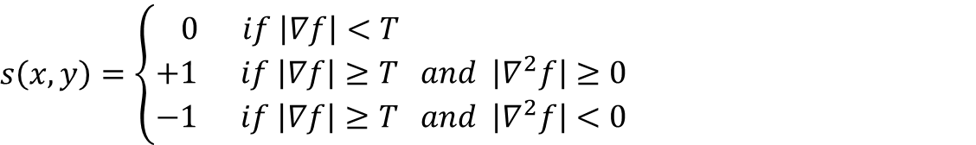
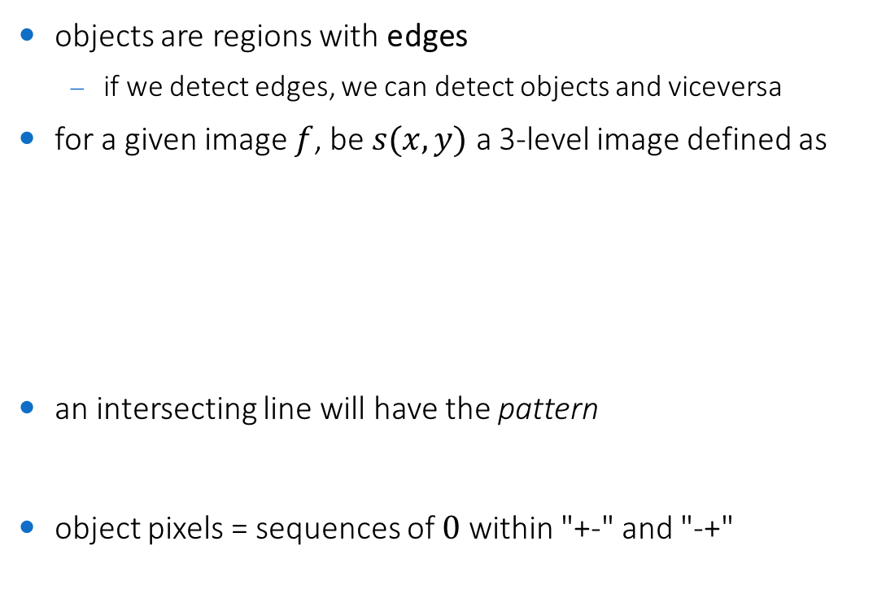
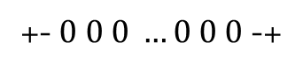
Variable thresholding: edge-based
objects are regions with edges
if we detect edges, we can detect objects and viceversa
for a given image $f$, be $s(x,y)$ a 3-level image defined as
an intersecting line will have the pattern
object pixels = sequences of $0$ within "+-" and "-+"
non-edge pixels
$$s\left(x,y\right)=\left\{\begin{aligned}0 if \left|∇f\right|<T \\ +1 if \left|∇f\right|≥T and \left|∇^{2}f\right|≥0 \\ −1 if \left|∇f\right|≥T and \left|∇^{2}f\right|<0\end{aligned}\right.$$
edge pixels (outer border)
edge pixels (inner border)
+- $0 0 0 …0 0 0$ -+

Slide 17
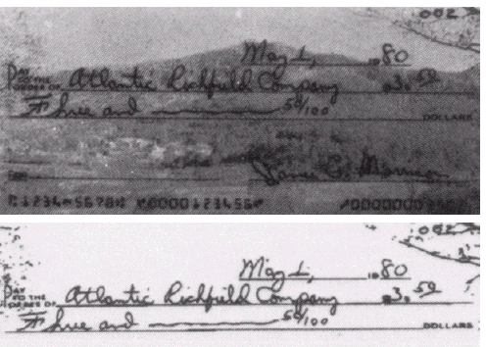
Variable thresholding: edge-based

Slide 18
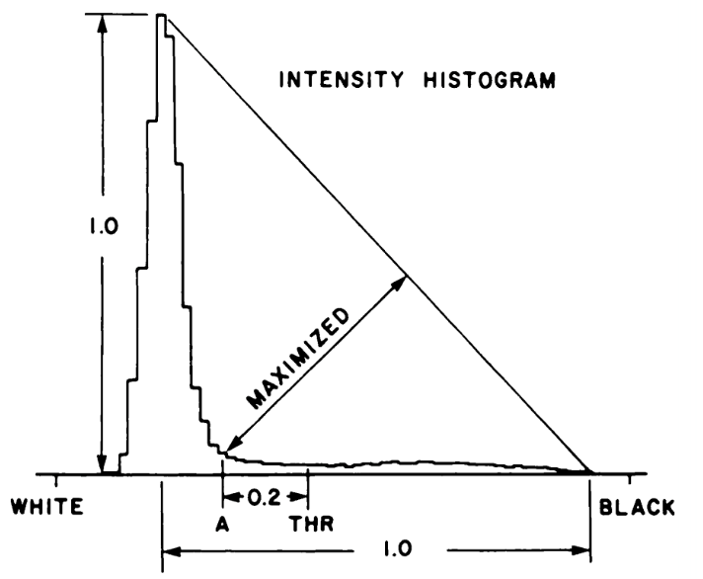
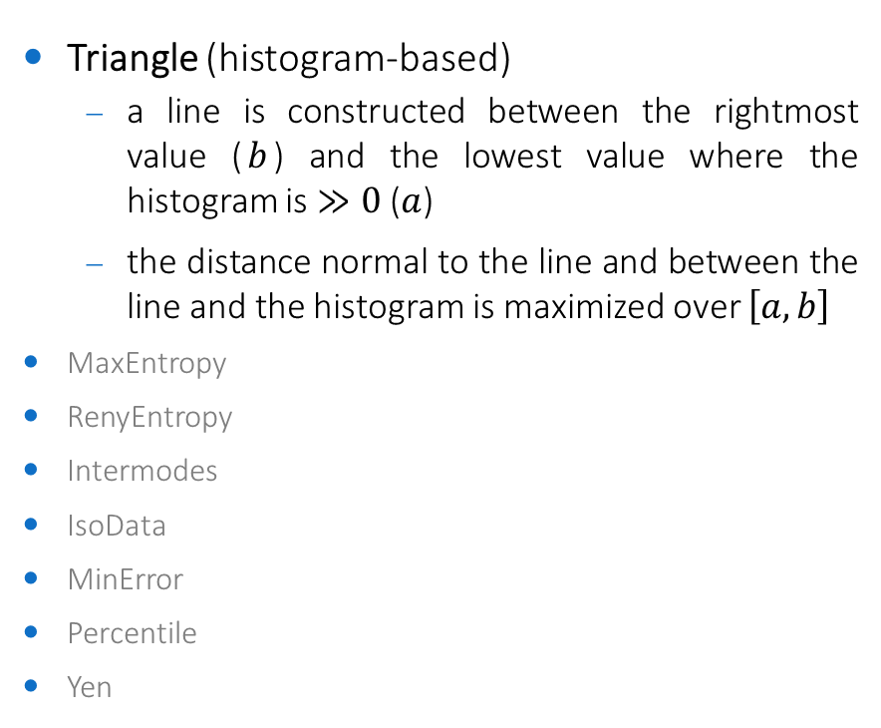
Other thresholding methods
Triangle (histogram-based)
a line is constructed between the rightmost value ($b$) and the lowest value where the histogram is $≫0$ ($a$)
the distance normal to the line and between the line and the histogram is maximized over $\left[a,b\right]$
MaxEntropy
RenyEntropy
Intermodes
IsoData
MinError
Percentile
Yen

Slide 19
Binary image analysis

Slide 20
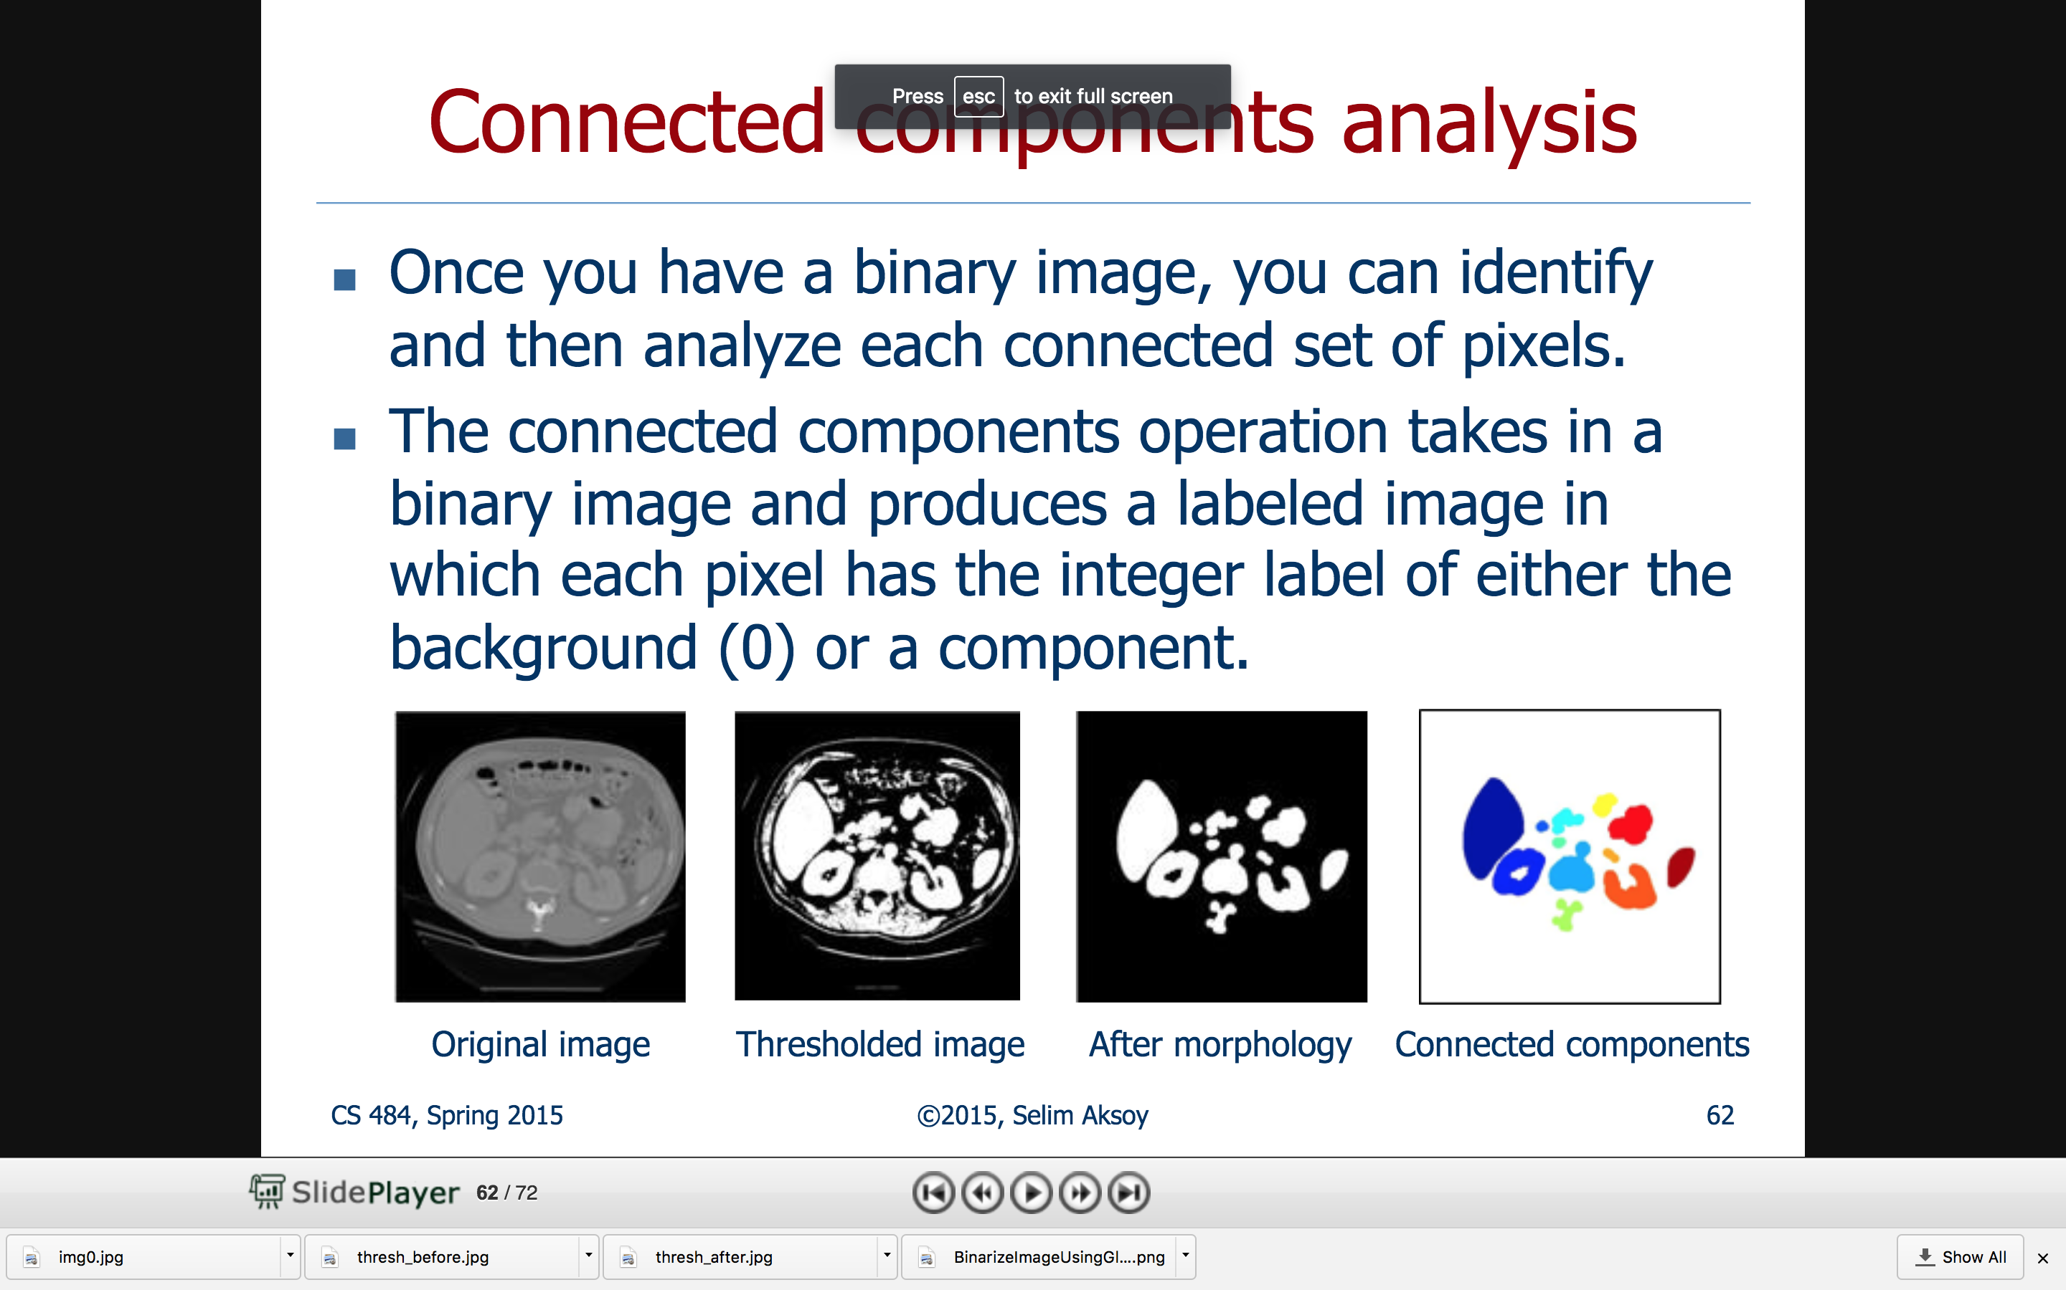
Motivations
binary images are the result of image processing techniques such as thresholding
results aren't perfect: objects might be fragmented and confused with other structures
we often need post-processing to
clean the segmentation results and enhance certain structures
Mathematical Binary Morphology (specialization of nonlinear spatial filtering)
find all objects and filter them according to their characteristics (features)
Connected Component Analysis
find only certain objects (parameterizable curves)
Hough transform
original
binarized
filtered
components

Slide 21
Connected Components

Slide 22
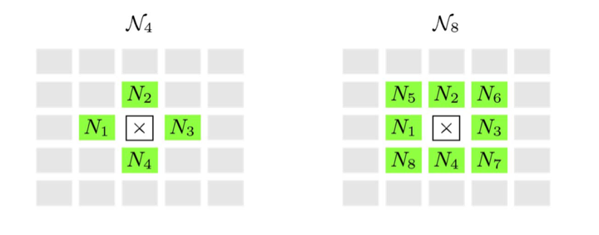
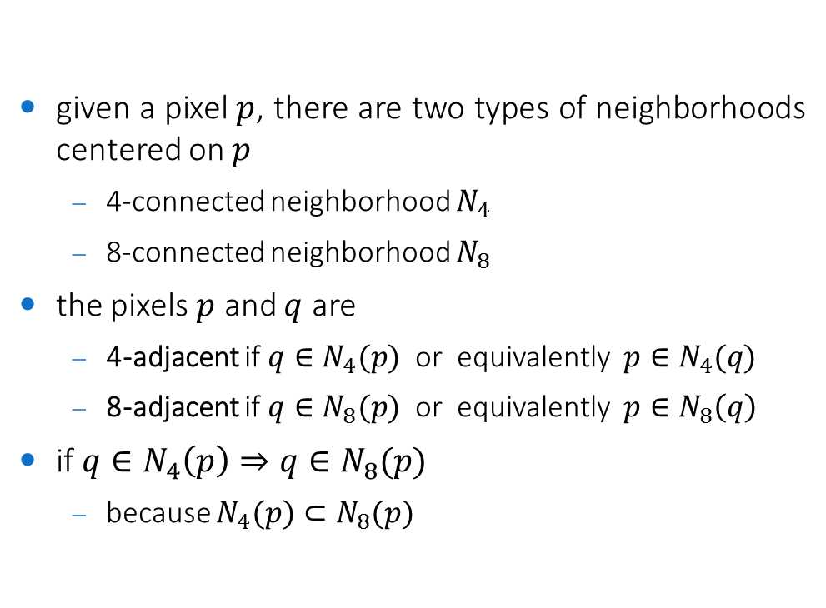
Adjacency
given a pixel $p$, there are two types of neighborhoods centered on $p$
4-connected neighborhood $N_{4}$
8-connected neighborhood $N_{8}$
the pixels $p$ and $q$ are
4-adjacent if $q∈N_{4}(p)$ or equivalently $p∈N_{4}(q)$
8-adjacent if $q∈N_{8}(p)$ or equivalently $p∈N_{8}\left(q\right)$
if $q∈N_{4}\left(p\right)⇒q∈N_{8}(p)$
because $N_{4}(p)⊂N_{8}(p)$

Slide 23
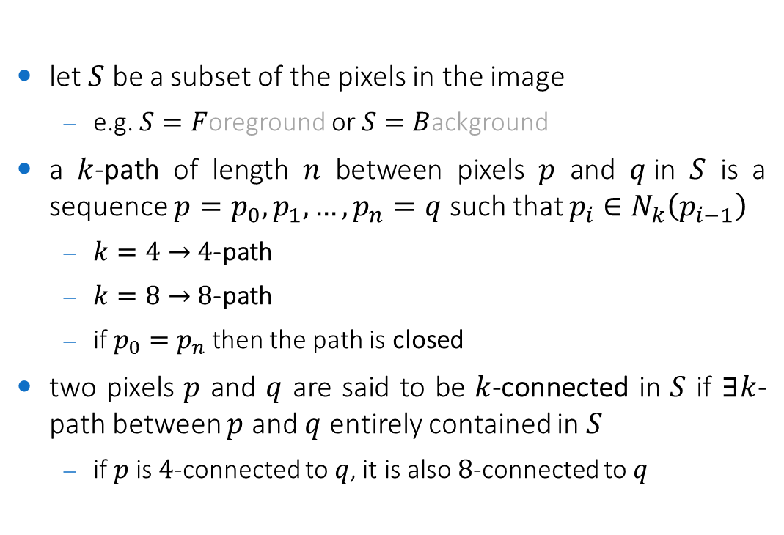
Paths
let $S$ be a subset of the pixels in the image
e.g. $S=F$oreground or $S=B$ackground
a $k$-path of length $n$ between pixels $p$ and $q$in $S$ is a sequence $p=p_{0},p_{1},…,p_{n}=q$ such that $p_{i}∈N_{k}\left(p_{i−1}\right)$
$k=4→$ $4$-path
$k=8→$ $8$-path
if $p_{0}=p_{n}$ then the path is closed
two pixels $p$ and $q$ are said to be $k$-connected in $S$ if $∃k$-path between $p$ and $q$ entirely contained in $S$
if $p$ is $4$-connected to $q$, it is also $8$-connected to $q$

Slide 24
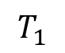
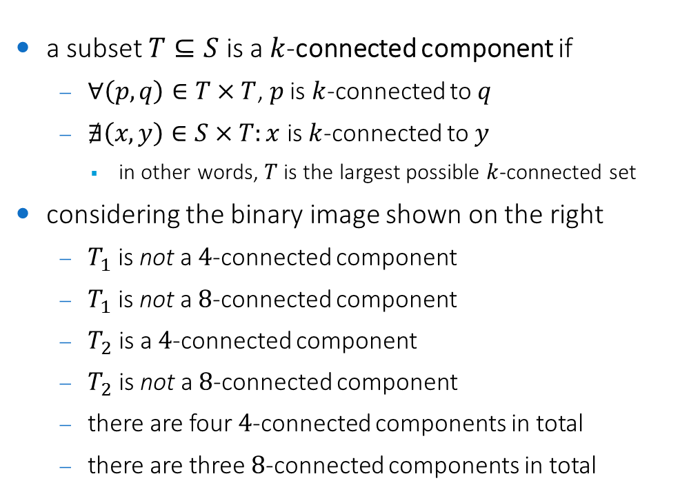
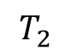
Connected components
a subset $T⊆S$ is a $k$-connected component if
$∀\left(p,q\right)∈T×T$, $p$ is $k$-connected to $q$
$∄\left(x,y\right)∈S×T:x$ is $k$-connected to $y$
in other words, $T$ is the largest possible $k$-connected set
considering the binary image shown on the right
$T_{1}$ is not a $4$-connected component
$T_{1}$ is not a $8$-connected component
$T_{2}$ is a $4$-connected component
$T_{2}$ is not a $8$-connected component
there are four $4$-connected components in total
there are three $8$-connected components in total
•
•
•
∗
•
∗
∗
∗
∗
$$T_{1}$$
•
$$T_{2}$$

Slide 25
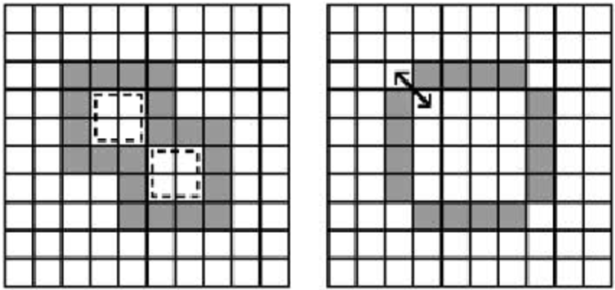
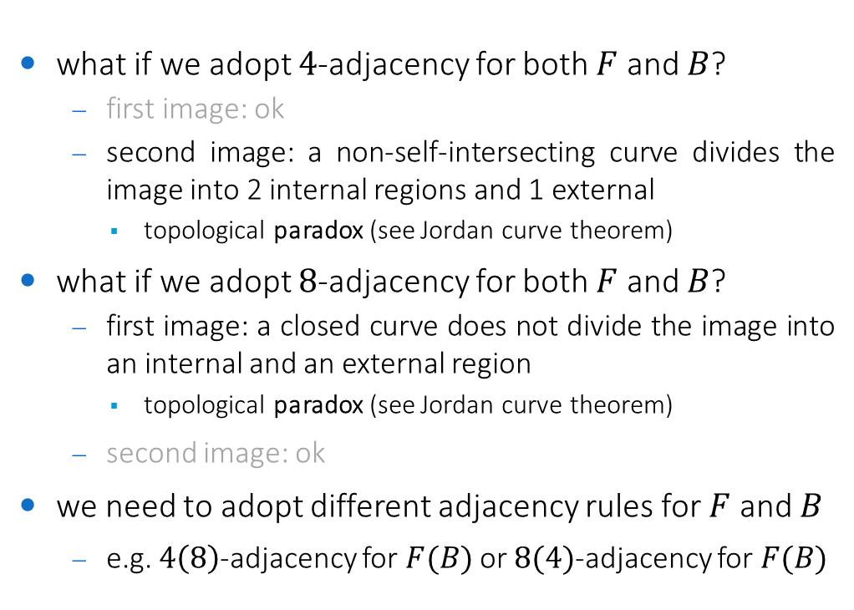
Connected components and adjacency
what if we adopt $4$-adjacency for both $F$ and $B$?
first image: ok
second image: a non-self-intersecting curve divides the image into 2 internal regions and 1 external
topological paradox (see Jordan curve theorem)
what if we adopt $8$-adjacency for both $F$ and $B$?
first image: a closed curve does not divide the image into an internal and an external region
topological paradox (see Jordan curve theorem)
second image: ok
we need to adopt different adjacency rules for $F$ and $B$
e.g. $4\left(8\right)$-adjacency for $F(B)$ or $8(4)$-adjacency for $F(B)$

Slide 26
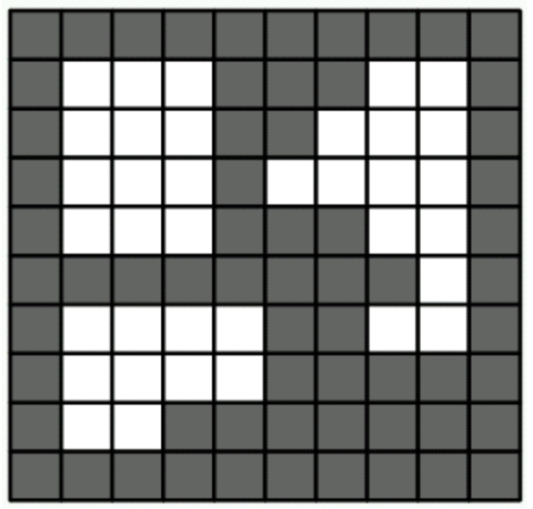
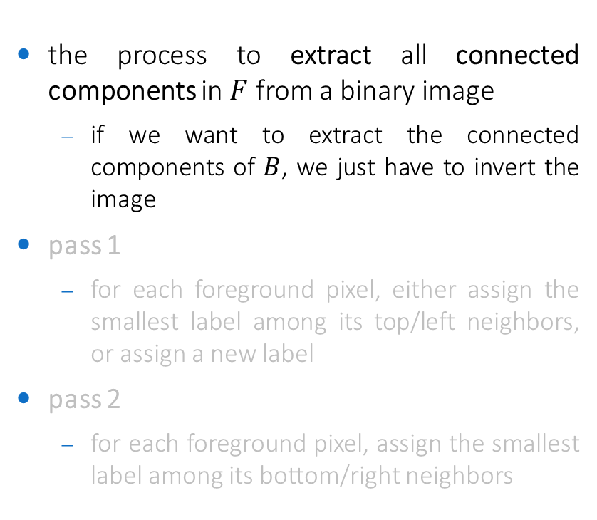
Connected Component Labeling
the process to extract all connected components in $F$ from a binary image
if we want to extract the connected components of $B$, we just have to invert the image
pass 1
for each foreground pixel, either assign the smallest label among its top/left neighbors, or assign a new label
pass 2
for each foreground pixel, assign the smallest label among its bottom/right neighbors

Slide 27
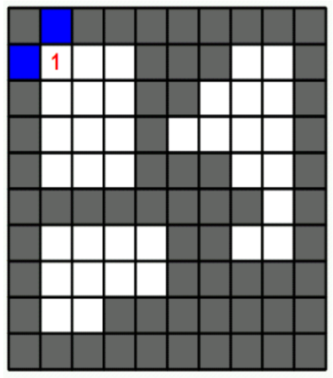
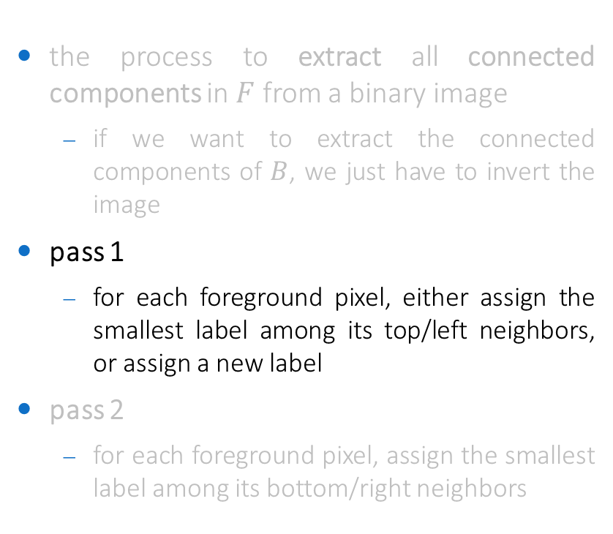
Connected Component Labeling
the process to extract all connected components in $F$ from a binary image
if we want to extract the connected components of $B$, we just have to invert the image
pass 1
for each foreground pixel, either assign the smallest label among its top/left neighbors, or assign a new label
pass 2
for each foreground pixel, assign the smallest label among its bottom/right neighbors

Slide 28
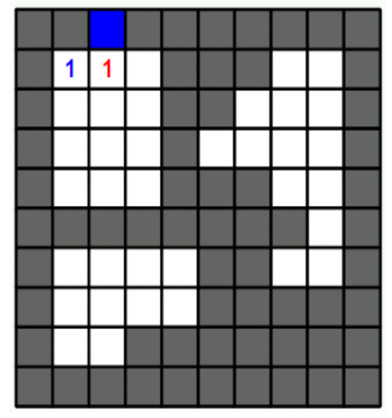
Connected Component Labeling
the process to extract all connected components in $F$ from a binary image
if we want to extract the connected components of $B$, we just have to invert the image
pass 1
for each foreground pixel, either assign the smallest label among its top/left neighbors, or assign a new label
pass 2
for each foreground pixel, assign the smallest label among its bottom/right neighbors

Slide 29
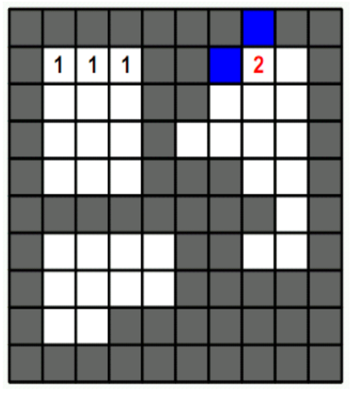
Connected Component Labeling
the process to extract all connected components in $F$ from a binary image
if we want to extract the connected components of $B$, we just have to invert the image
pass 1
for each foreground pixel, either assign the smallest label among its top/left neighbors, or assign a new label
pass 2
for each foreground pixel, assign the smallest label among its bottom/right neighbors

Slide 30
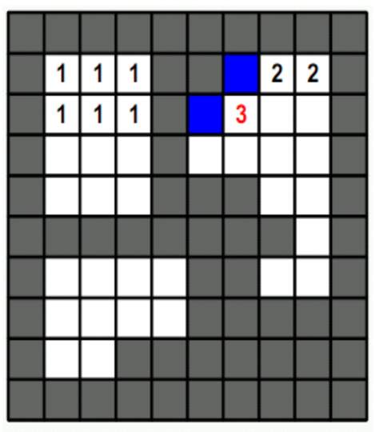
Connected Component Labeling
the process to extract all connected components in $F$ from a binary image
if we want to extract the connected components of $B$, we just have to invert the image
pass 1
for each foreground pixel, either assign the smallest label among its top/left neighbors, or assign a new label
pass 2
for each foreground pixel, assign the smallest label among its bottom/right neighbors

Slide 31
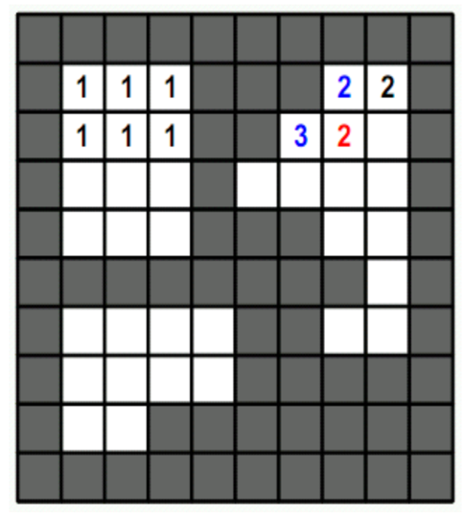
Connected Component Labeling
the process to extract all connected components in $F$ from a binary image
if we want to extract the connected components of $B$, we just have to invert the image
pass 1
for each foreground pixel, either assign the smallest label among its top/left neighbors, or assign a new label
pass 2
for each foreground pixel, assign the smallest label among its bottom/right neighbors

Slide 32

Connected Component Labeling
the process to extract all connected components in $F$ from a binary image
if we want to extract the connected components of $B$, we just have to invert the image
pass 1
for each foreground pixel, either assign the smallest label among its top/left neighbors, or assign a new label
pass 2
for each foreground pixel, assign the smallest label among its bottom/right neighbors

Slide 33


Connected Component Labeling
the process to extract all connected components in $F$ from a binary image
if we want to extract the connected components of $B$, we just have to invert the image
pass 1
for each foreground pixel, either assign the smallest label among its top/left neighbors, or assign a new label
pass 2
for each foreground pixel, assign the smallest label among its bottom/right neighbors

Slide 34




Connected Component Analysis
compute mathematical properties of a connected components to use for human-designed (threshold-based) or machine-learned classification
e.g. geometric features like area, circularity ($C$), orientation, etc.
e.g. color features like average hue , average luminance, etc.
e.g. texture features
see "Feature descriptors" module of this course
bounding rectangle
minimum area bounding rectangle
$$θ$$
$$C=\frac{4πA}{P^{2}}$$

Slide 35

Exercise
create a UI for object picking (Magic Wand-like)
binarization with Otsu and/or Triangle
background artifacts removal with local filtering and/or connected components filtering
object selection with mouse callback and point in polygon test
display of selected object with image blending
solution in /exercises/object-picking-ui.cpp

Slide 36

Exercise
implement an app for traffic light recognition
use binarization with Otsu or Triangle
extract connected components
detect the "red", "yellow" and "green" lights among the connected components extracted
display the result
should work in real-time (video processing)
try the video in example_images/traffic_light.mp4
solution in /exercises/traffic-light-recognition.cpp

Slide 37
Mathematical Morphology (for binary images)

Slide 38



Morphological processing
exploits the a-priori knowledge of the shape features of the objects in the image
it is a branch of set theory
widely used as post-processing step after image binarization
cleaning
filling/reconstruction
skeletonization

Slide 39


Definitions
given a set $B$ defined in a 2D domain $ℤ^{2}$ w.r.t. an origin
the reflection of $B$ is $\hat{B}=\left\{−b \right| b∈B\}$
the translation of $B$ by $z=(z_{1},z_{2})$ is $B_{z}=\left\{b+z \right| b∈B\}$

Slide 40


Structuring element
morphological operations are defined w.r.t. a set called structuring element (SE)
structuring elements are defined w.r.t. an origin
typically (but not always), their barycenter
structuring elements are described using the following convention:
point: barycenter
filled cell: belongs to the SE
void cell: does not belong to the SE
cross: don't care

Slide 41


Dilation and Erosion: definition
dilation of a binary set $A$ with a SE $B$ tests, for each point $x$ of the plane, if $B$ centered on $x$intersects $A$
$A ⨁ B =\left\{x |{ \left(\hat{B}\right)}_{x}∩A≠∅\right\}$
it results in a set larger than the original set
erosion of a binary set $A$ with a SE $B$ tests, for each point $x$ of the plane, if $B$ centered on $x$is contained in $A$
$A⊖B=\left\{x | {\left(B\right)}_{x}⊆A\right\}$
it results in a set smaller than original set

Slide 42


Dilation: examples
dilation fills the (background) spaces between fragments (of foreground)
dilation with a cross SE $3×3$
original

Slide 43

Dilation: examples
dilation dilates the foreground objects (an)isotropically if the SE is (an)isotropic

Slide 44


Erosion: examples
erosion fills the (foreground) spaces between fragments (of background)
erosion with a square SE $45×45$
original

Slide 45

Erosion: examples
erosion erodes the foreground objects (an)isotropically if the SE is (an)isotropic

Slide 46


Duality between dilation and erosion
erosion and dilation are operations dual with respect to the complement and reflection
${\left(A⊖B\right)}^{C}=A^{C}⨁$ $\hat{B}$
$${\left(A⨁B \right)}^{C}=A^{C}⊖\hat{B}$$
if the structuring element is symmetric ($\hat{B}=B$), erosion of $A$ can be obtained by dilating the background, $A^{C}$, with the same structuring element, and complementing the result
viceversa for the dilation
original
dilation
inverted
erosion
inverted

Slide 47



Opening and Closing: definition
opening of a binary set $A$ with a SE $B$ is
$A○B =(A$ $⊖B) ⨁ B$
eliminates foreground where the SE can't fit
cuts protrusions and bridges smaller than the SE
closing of a binary set $A$ with a SE $B$ is
$A•B =(A$ $⨁$ $B)⊖B$
eliminates background where the SE can't fit
fills holes and gulfs smaller than the SE

Slide 48

Opening and Closing: properties
duality
$${\left(A○B\right)}^{C}=A^{C}•\hat{B}$$
$${\left(A•B \right)}^{C}=A^{C}○\hat{B}$$
hierarchy
$$A○B⊆A⊆A•B$$
idempotence
$$\left(A○B\right)○B=A○B$$
$$\left(A•B\right)•B=A•B$$

Slide 49


Opening and Closing: an example
opening and closing can be used for noise/artifacts filtering
the fingerprint in $A$ is affected by noise (binarization artifacts)
eroding, the outer noise is eliminated, but inner noise is improved
after dilation, the original dimension of the ridges can be recovered and the inner noise is canceled
erosion + dilation = opening

Slide 50

Opening and Closing: an example
noise has been removed by the opening, but this processing stage caused the interruption of some ridges
by dilating, the continuity of the ridges can be recovered
erosion restores the original thickness of the ridges
dilation + erosion = closing

Slide 51
Exercise
modify exercise "Object picking UI" by performing background artifacts removal with binary morphology
solution in /exercises/object-picking-ui.cpp

Slide 52


Border extraction
the border of $A$, $β(A)$, can be obtained by
$$β\left(A\right)=A−(A⊖B)$$
the shape (and the size) of $B$ affects the thickness of the border

Slide 53

Hit-or-Miss
detects all occurrences of a given [foreground ($B_{1}$), background ($B_{2}$)] pattern
$B_{1}$ and $B_{2}$ are two SEs
erode $A$with $B_{1}$ (hit)
result: pixels whose foreground neighborhood matches with $B_{1}$
erode $A^{C}$ with $B_{2}$ (miss)
result: pixel whose background neighborhood matches with $B_{2}$
intersect the two results
$$A⊛(B_{1},B_{2})=(A⊖B_{1})∩(A^{C}⊖B_{2})$$
example: detect all occurrences of $D$ surrounded by at least 1 pixel of background
then $B_{1}=D$ and $B_{2}=W−D$ , where $W$ slightly larger (1 pixel) than $D$

Slide 54

Hit-or-Miss

Slide 55





Hit-or-Miss
foreground-background SEs can be merged into a single SE where
filled cell: foreground to match
void cell: background to match
cross: don't care
x
x
x
x
$$I$$
$$B$$
$$I⊛B$$

Slide 56


Thinning and Skeletonization
thinning of a set $A$ through $B$ is defined as
$$A⊗B=A−(A⊛B)$$
i.e. removes from $A$ all the instances of $B$ found by the hit-or-miss transform
the result depends on the orientation of $B$, i.e. if $B$ is a "right-edge"-like pattern, all right edges will be eroded
skeletonization can be achieved by iteratively thinning using a sequence of SEs like:
to be repeatedly applied in sequence until convergence (no more changes)

Slide 57

Skeletonization: example

Slide 58


Exercise
use skeletonization and hit-or-miss transforms to detect triple points (junctions) in a binary vessel tree
OpenCV uses the following convention for hit-or-miss SEs:
$−1$= background
$+1$ = foreground
$0$ = don't care
pruning might be needed to remove spurious junctions generated by skeletonization
use and endpoint-like SE
x
x
x
solution in /exercises/detect-junctions.cpp

Slide 59

Reconstruction
it is an iterative morphological transformation that aims at reconstructing foreground objects starting from a subset of points (marker)
marker $F$
the transformation (dilation or erosion) starts from the foreground points in $F$ and is repeated until convergence (no more changes)
$F$should contain seeds for the objects we want to reconstruct, and be zero elsewhere
if the transformation is dilation, then it must be $F⊆G$
if the transformation is erosion, then it must be $F⊇G$
mask $G$
acts as constraint for the repeated dilations/erosions of $F$
geodesic dilation/erosion
usually it is the original image

Slide 60

Reconstruction
reconstruction by dilation
geodesic dilation of size $k→$ $D_{G}^{\left(k\right)}\left(F\right)=D_{G}^{\left(1\right)}\left(D_{G}^{\left(k−1\right)}(F)\right)$
where $D_{G}^{\left(0\right)}\left(F\right)=F$ and$D_{G}^{\left(1\right)}\left(F\right)=\left(F⨁{B}\right)∩G$
$R_{G}^{D}\left(F\right)=D_{G}^{\left(n\right)}\left(F\right)$ so that $D_{G}^{\left(n\right)}\left(F\right)=D_{G}^{\left(n−1\right)}\left(F\right)$ (convergence)
reconstruction by erosion
geodesic erosion of size $k→$ $E_{G}^{\left(k\right)}\left(F\right)=E_{G}^{\left(1\right)}\left(E_{G}^{\left(k−1\right)}(F)\right)$
where $E_{G}^{\left(0\right)}\left(F\right)=F$ and$E_{G}^{\left(1\right)}\left(F\right)=\left(F⊖B\right)∪G$
$R_{G}^{E}\left(F\right)=E_{G}^{\left(n\right)}\left(F\right)$ so that $E_{G}^{\left(n\right)}\left(F\right)=E_{G}^{\left(n−1\right)}\left(F\right)$ (convergence)

Slide 61

Reconstruction by Dilation (1/2)

Slide 62

Reconstruction by Dilation (2/2)

Slide 63


Opening by Reconstruction
original image $I$ (= mask $G$)
marker $F$ = erosion of $I$ with a vertical SE (e.g. $24×1$)
reconstruction by dilation
when the marker is obtained by an erosion and the reconstruction is based on dilation, the operation is also called opening by reconstruction

Slide 64



Hole filling through reconstruction
given a binary image $I(x,y)$ with holes
generate a marker image $F(x,y)$ as
$$F\left(x,y\right)=\left\{\begin{aligned}I^{C}\left(x,y\right) \\ 0 \end{aligned}\right.$$
then the hole-filled image $H(x,y)$ is
$$H\left(x,y\right)={\left(R_{I^{C}}^{D}\left(F\right)\right)}^{C}$$
if $\left(x,y\right)∈∂I$
otherwise

Slide 65



Exercise
use opening by reconstruction followed by hole filling to select long characters in a text image and fill their holes (where present)
in OpenCV
the intersection between binary images is available using the operator &
countNonZero(cv::abs(img1-img2)) will yield 0 only if the two images are identical v
solution in /exercises/fill-long-characters.cpp

Slide 66


Hough Transform

Slide 67

Motivation
a tool used to detect parameterizable curves from binary images
curves that can be described with parametric equations (analytic geometry)
invented by Paul Hough (1962)
independently discovered by Duda & Hart (1972) who called it Generalized Hough Transform
the most used Hough transform is the Hough Line Transform
detects lines from fragments/points

Slide 68


Equation of a line
$y=kx+d$
idea: two (or more) points (line fragments) lying on the same line share the same line parameters $k$ and $d$
through a majority voting scheme, we can find the most "populated" (=strongest) lines!

Slide 69


From image space to parameter space
suppose that a binary image has 5 nonzero pixels
each point corresponds to a line in the $(k,d)$ parameter space
$\left(1,0\right)⟶d=−k$
$\left(1,1\right)⟶d=−k+1$
$\left(2,1\right)⟶d=−2k+1$
$\left(4,1\right)⟶d=−4k+1$
$\left(3,2\right)⟶d=−3k+2$
in the parameter space, we can find the $(k,d)$ pairs (=lines in the image space) where most lines intersect

Slide 70

From image space to parameter space
points in the parameter space corresponding to the max number of intersections ($3$) are:
$\left(k,d\right)=\left(0, 1\right) ⟶y=1$
$\left(k,d\right)=\left(1, −1\right)⟶y=x−1$
indeed, in the image space, among all possible lines that pass through the 5 points, these two lines are the two "most likely" lines

Slide 71

From image space to parameter space
more formally, there is a bidirectional relationship between lines (points) in the image space and points(lines) in the parameter space

Slide 72

Accumulator matrix
problem: how to detect all intersections in the parameter space?
solution: discretize the parameter space and use an accumulator matrix
given a point in the binary image, increment all points on the corresponding line in the parameter space
the points in the parameter space that received the highest counts (majority voting) corresponds to the strongest lines in the image space

Slide 73



Polar coordinates
problem: how to represent vertical lines ($k=∞$)?
solution: parameterize the lines in the image space using polar coordinates $(ρ,θ)$
$ρ$ = perpendicular distance of line from the origin
$θ$ = angle of line's perpendicular to $x$ axis
$$ρ$$

Slide 74







From image space to parameter space (polar coordinates)
there is a bidirectional relationship between lines (points) in the image space and points (sinusoids) in the parameter space
$$y$$
A
$$ρ$$
$$ρ_{0}=x∙\cos\left(θ\right)+y∙sin⁡(θ)$$
C
B
$$x$$
B
$$θ$$
C
A
$${(ρ}_{0},θ_{0})$$

Slide 75

Robustness to noise

Slide 76


Other curves
the Hough transform is not limited to lines, but can be used to detect any parameterizable curve
circles
$ρ^{2}={\left(u−x\right)}^{2}+{\left(v−y\right)}^{2}$
accumulator matrix is 3-dimensional
ellipses
accumulator matrix is 5-dimensional
...
see Generalized Hough Transform (4-d space)

Slide 77

Exercise
use the Hough Line Transform to detect the main lines in a road image
the input of the Hough Line Transform should be a binary image where the edges have been enhanced
use a thresholded gradient image
in OpenCV, the Hough Line Transform is
void HoughLines(cv::Mat image, cv::Mat lines, double drho, double dtheta, int threshold)
the output lines are stored in descending order of accumulation
solution in /exercises/hough-line-detection.cpp

